Slide 1
MILAGRO 2023 MARGARITA MOBILE TOUR RECAP
8/28 – 9/3

Slide 2
Van Tour Weekly Stats 8/28-9/3
Activation Hours: 13
Miles Driven: 292
Hours Driven: 7
Day | Miles Driven | Hours Driven
Monday | 0 | 0
Tuesday | 0 | 0
Wednesday | 0 | 0
Thursday | 0 | 0
Friday | 254 | 4:27
Saturday | 19 | 1:28
Sunday | 19 | 0:55

Slide 3
ACTIVATIONS
On-Premise
Activation: 13
Samples: 575
On Premise
Venue | Activation Hours | Samples | Full Serve
Hotel Zaza | 3 | 50 | 0
Rangers Stadium | 5 | 250 | 0
Rangers Stadium | 5 | 275 | 0

Slide 4
On Premise
Hotel Zaza – 9/1
Recap: The Milagro van posted outside the eclectic Hotel Zaza in uptown Dallas. As guests arrived at the hotel, they were greeted with a sample of a Milagro margaritas and a choice of sunglasses, pop sockets or branded shot cup necklaces. Guests chatted up the Brand Ambassador about how fun the van was and how much they enjoyed the sample.
Rangers Stadium – 9/2, 9/3
Recap: The Milagro van traveled to Ranger Stadium for a fun weekend of baseball. Thousands of fans walked by the van as they entered the stadium. It was the perfect location to set up the Milagro van! The Milagro margarita samples went very quickly. The Brand Ambassadors asked for an additional batch on both days. And that also went very quickly. Staff members from Live! loved the van and were excited to know that it will be back to Ranger Stadium again. They inquired about selling instead of sampling and were going to check in with their Milagro representative.

Slide 5
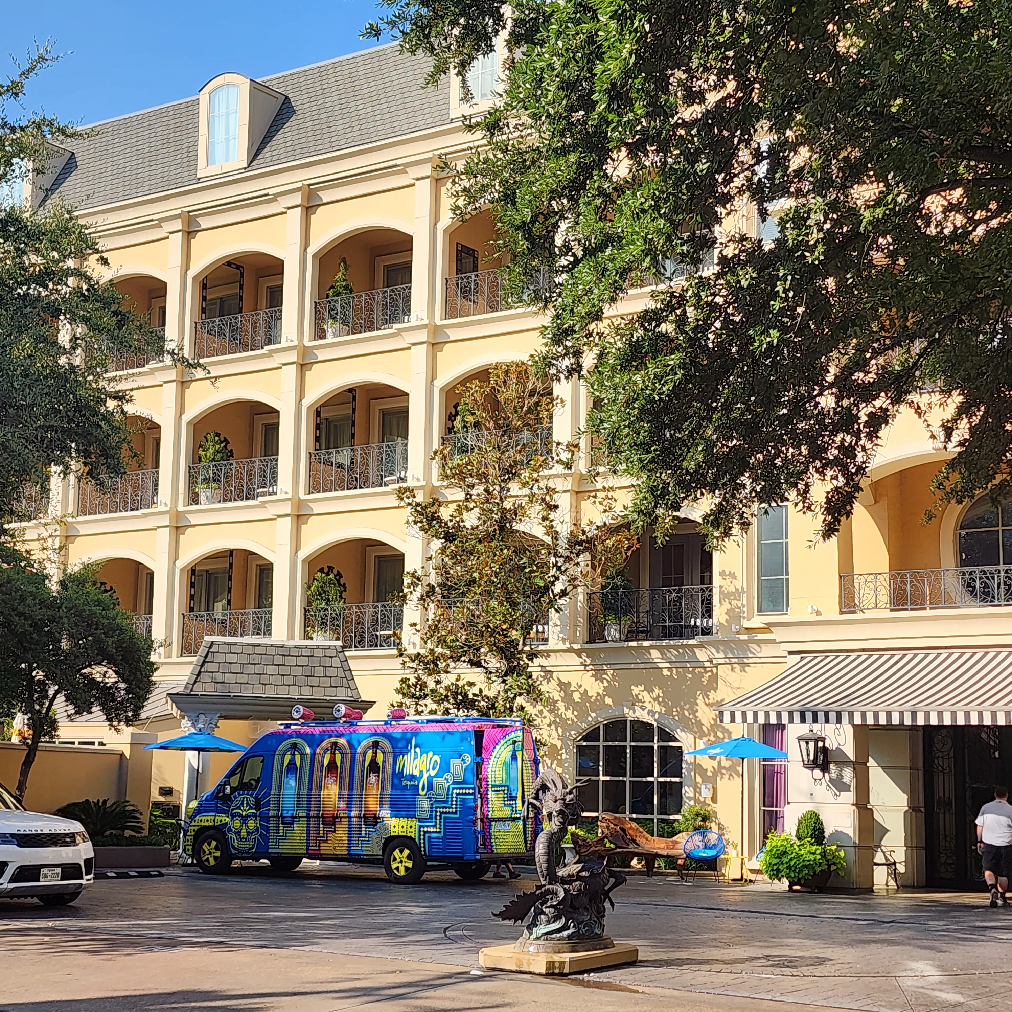
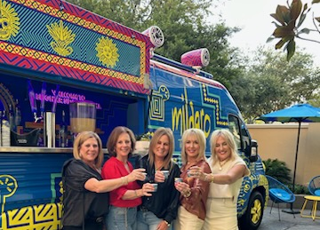
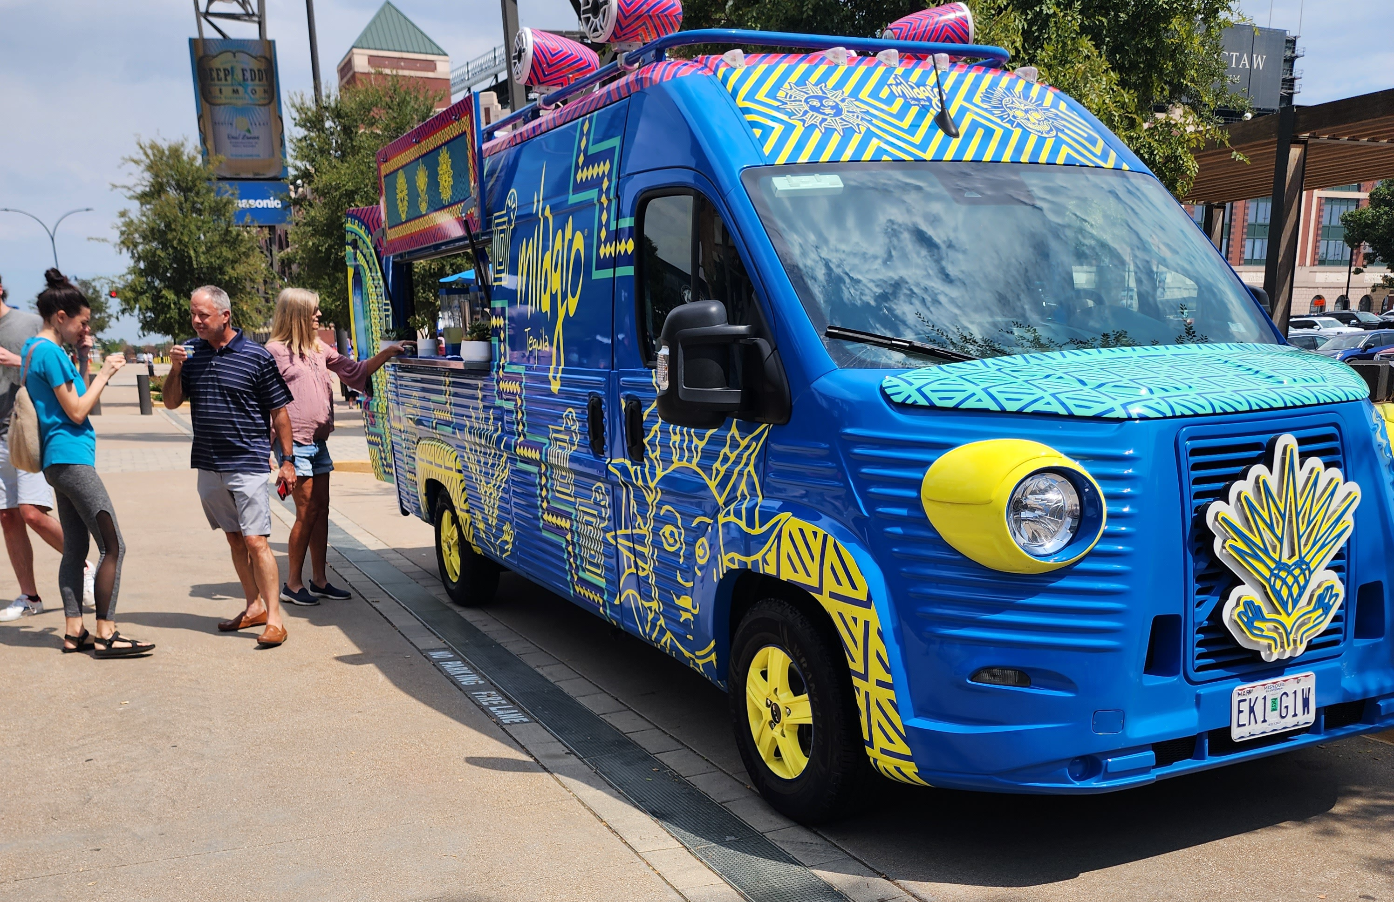

Slide 6
Market Data (May 4th – September 3rd)
Florida
Type of Activation​​ | # of Activation​​ | Estimated Attendance​​ | Samples​​ | Full Serve​​ | Bottles Sold​​
Off Premise​​ | 6​​ | 460​​ | 228​​ | 0​​ | 68​​
On Premise​​ | 18​​ | 3,250​​ | 1,239​​ | 785​​ | NA​​
Sponsorship​​ | 5​​ | 10,050​​ | 50​​ | 2,585​​ | NA​​
California (Arizona Pit Stop 7/7-7/8)
Type of Activation | # of Activation | Estimated Attendance | Samples | Full Serve | Bottles Sold
Off Premise | 2 | 700 | 75 | 0 | 0
On Premise | 14 | 4910 | 305 | 8,90 | 0
Sponsorship | 15 | 60100 | 40 | 6,742 | 0
Texas (8/25 – 11/12)
Type of Activation​​ | # of Activation​​ | Estimated Attendance​​ | Samples​​ | Full Serve​​ | Bottles Sold​​
Off Premise​​ | 1 | 50 | 30 |  | 13
On Premise​​ | 3 | 16,080 | 575
Sponsorship​​ | 1 | 8,000 | 1,140

Slide 7
THANK YOU

